Slide 1
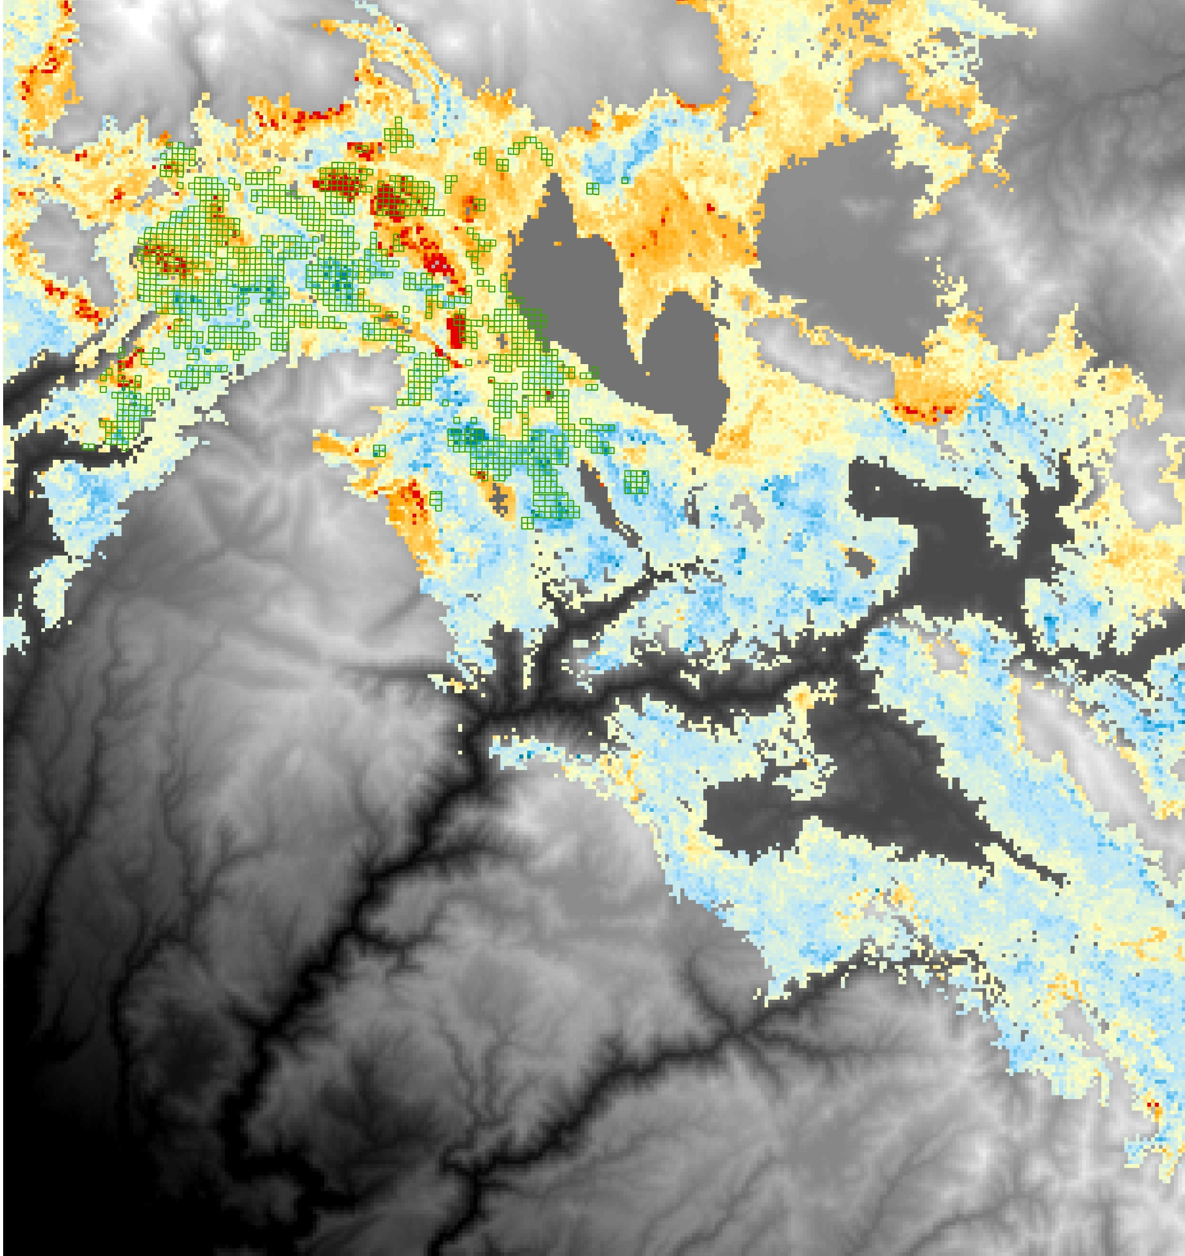
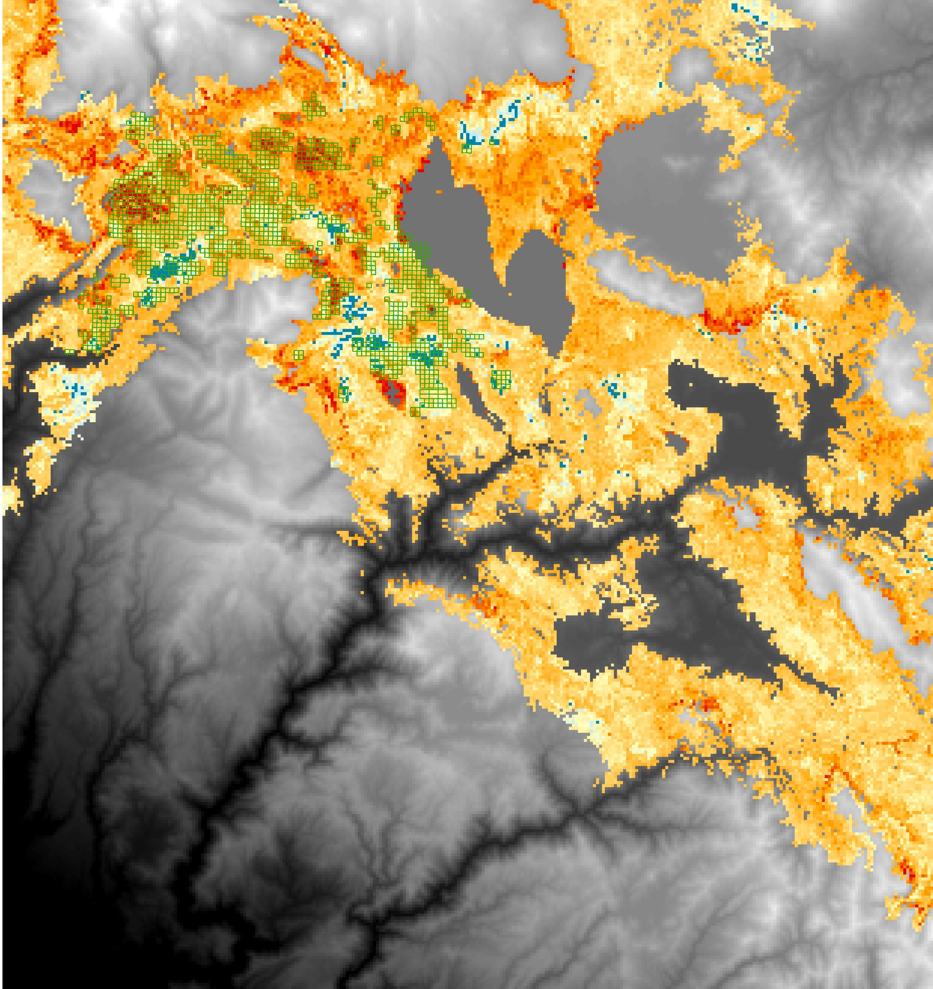
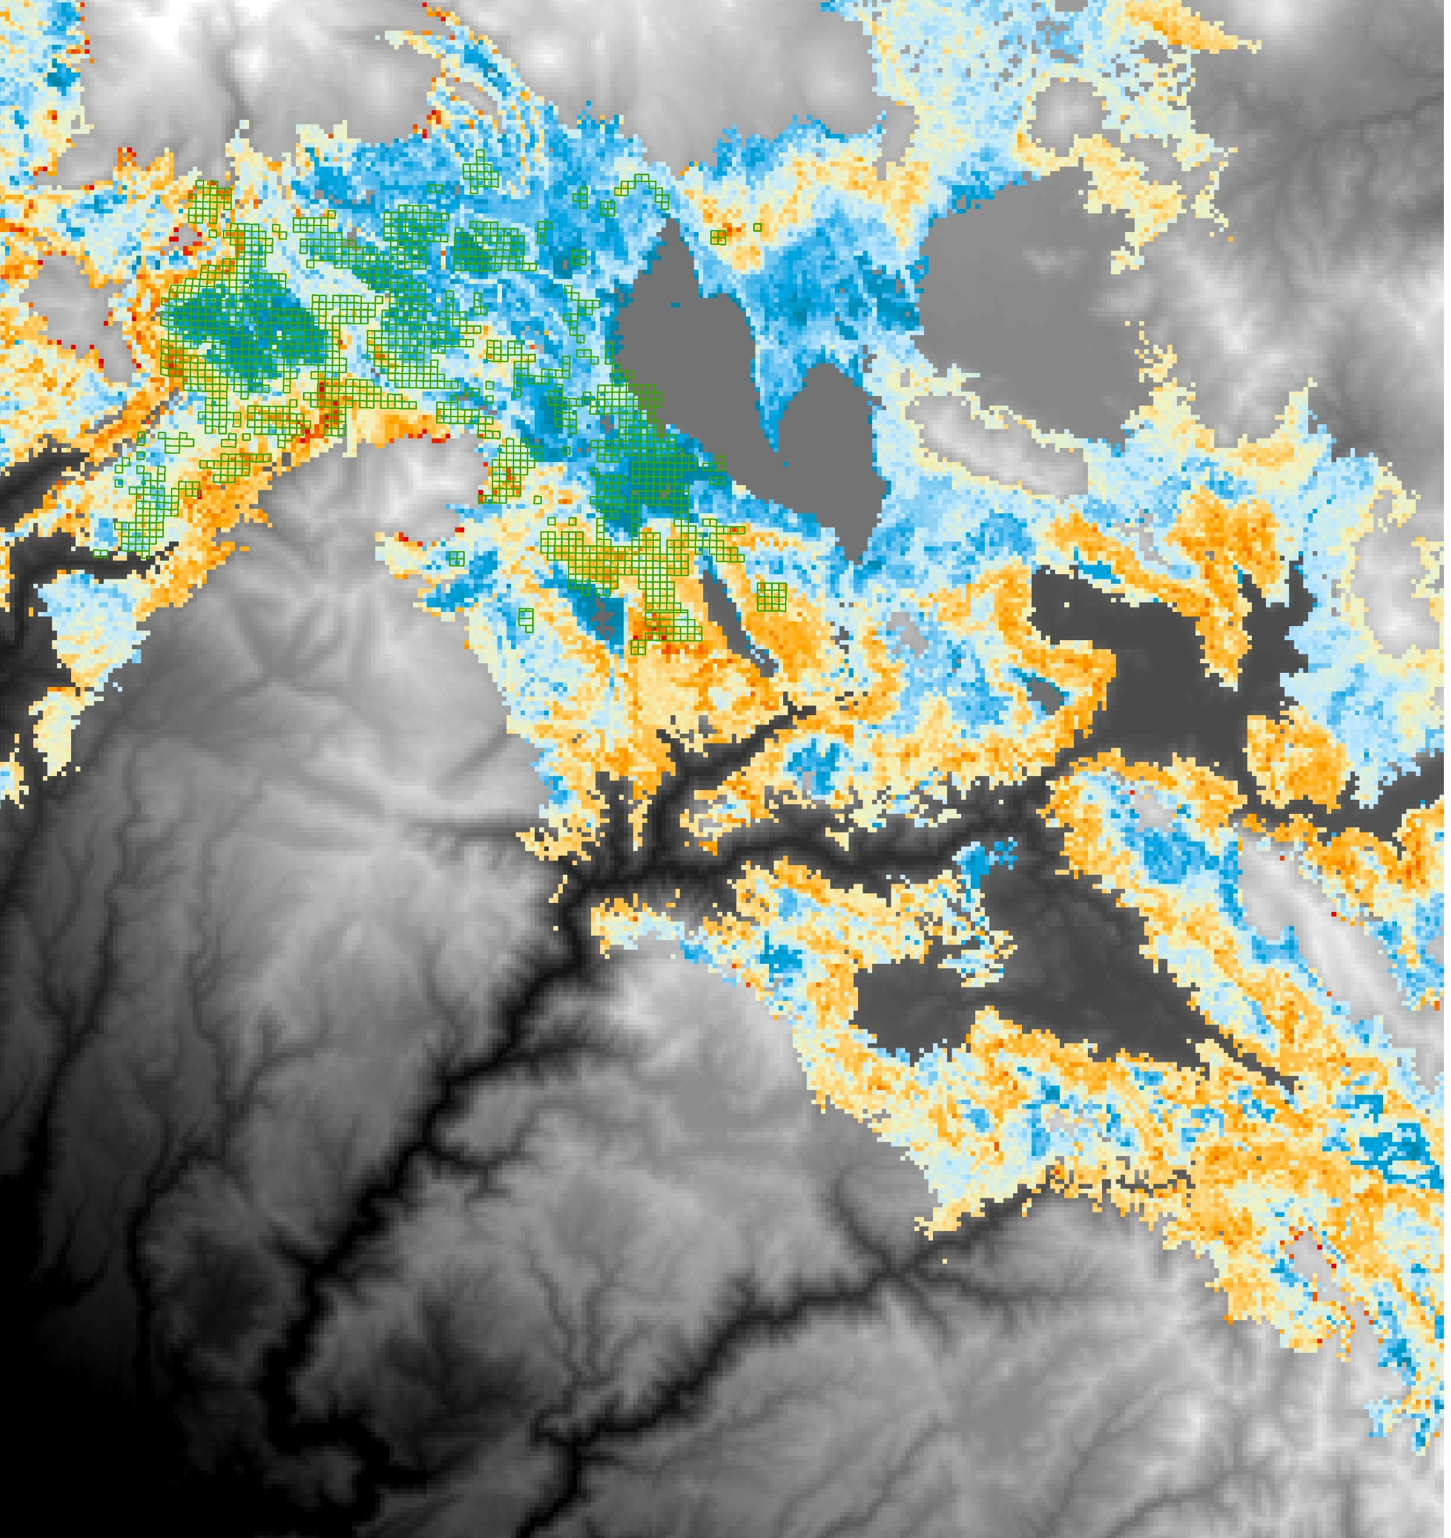
Sampled QQs
Sampled QQs
Predicted TPH
Predicted BA
(m² ha⁻¹)
27
35
11
43
15
50
19
58
23
66
26
Elevation (m)
Elevation (m)
0
2736
0
2736
Sampled QQs
Predicted pine fraction
0.38
0.48
0.56
0.64
0.71
0.96
Elevation (m)
0
2736

